Slide 1
LEARNING MANAMENT SYSTEM
WEBSITE-DESIGN
Sri Charan Reddy (19311A05Q2)
Y. Nikitha Reddy (19311A05R9)
D Emmanuel (19311A05V4)
Project Guide : Mr V. Satheesh
Project Co-Ordinator : Mr M. Sathyanarayana

Slide 2
CONTENTS
Abstract
Introduction
Literature Review
Architecture Diagram
Data Flow Diagram
ER Diagram
Use Case Diagram
Class Diagram
Sequence Diagram
Activity Diagram
Conclusion

Slide 3
ABSTRACT
Learning Management System is an educational content management system that aims to make the building of a platform as simple and intuitive as possible. Laravel’s Learning Management System (or LMS) allows you to manage courses and learning modules, making it easier to create instructional content. The platform is easy to use and includes features such as: The Professor (course creator) The College Student (or user).
Our website is built on the Laravel Learning Management System and the PHP programming language.
It offers a variety of useful features that enable all users to engage with one another. It also makes it easier to create instructional content by allowing you to manage courses and learning modules. This system, as well as the web application, has a clear concept that is similar to real-life scenarios and well-implemented.

Slide 4
INTRODUCTION
An LMS delivers and manages all types of content, including video, courses, workshops and documents. In the education and higher education markets, an LMS will include a variety of functionality that is similar to corporate but will have features such as rubrics, teacher and instructor-facilitated learning, a discussion board, and often the use of a syllabus. A syllabus is rarely a feature in the corporate LMS, although courses may start with heading-level index to give learners an overview of topics covered

Slide 5
LITERATURE REVIEW
There are several historical phases of distance education that preceded the development of the LMS:
Udemy: Udemy, Inc. is a global destination for teaching and learning online. It was founded in May 2010 by Eren Bali, Gagan Biyani, and Oktay Caglar.
Students take courses primarily to improve job-related skills. Some courses generate credit toward technical certification. Udemy has made a special effort to attract corporate trainers seeking to create coursework for employees of their company.
Byju’s: is an Indian multinational educational technology company, headquartered in Bangalore.^{[4]} It was founded in 2011 by Byju Raveendran and Divya Gokulnath.
In initial days the company focused on offering online video-based learning programs for the K-12 segment and for competitive exams. In 2012, the firm entered Deloitte Technology Fast 50 India and Deloitte Technology Fast 500 Asia Pacific ratings and has been present there ever since.

Slide 6
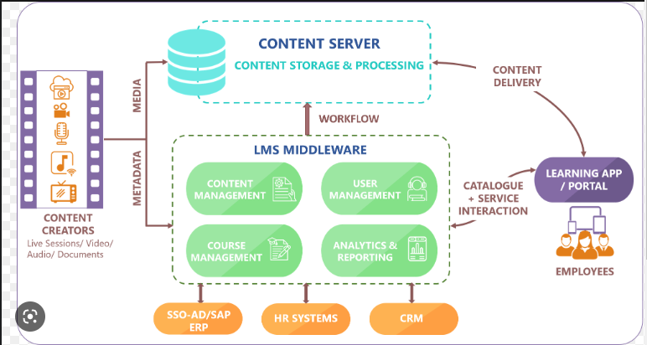
ARCHITECTURE DIAGRAM

Slide 7
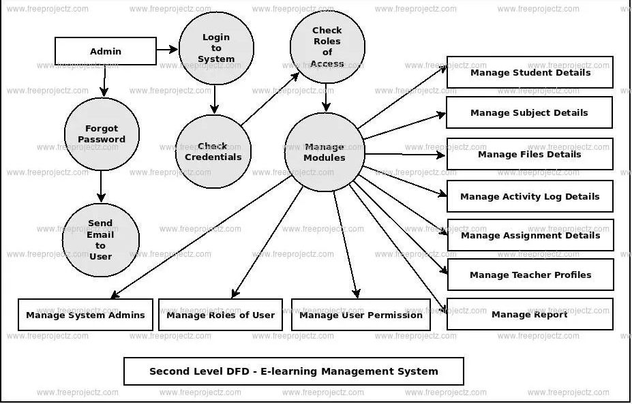
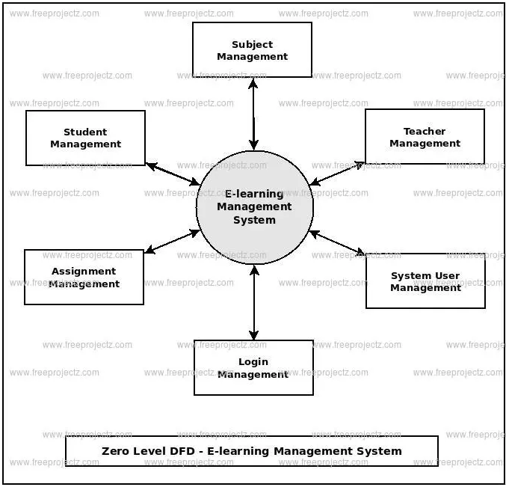
DATA FLOW DIAGRAM
ADMIN / TEACHER
STUDENT

Slide 8
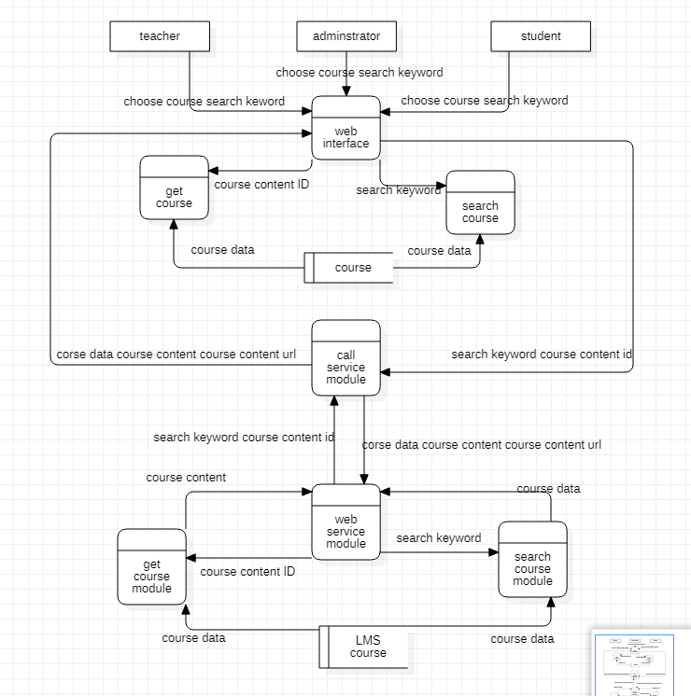

Slide 9
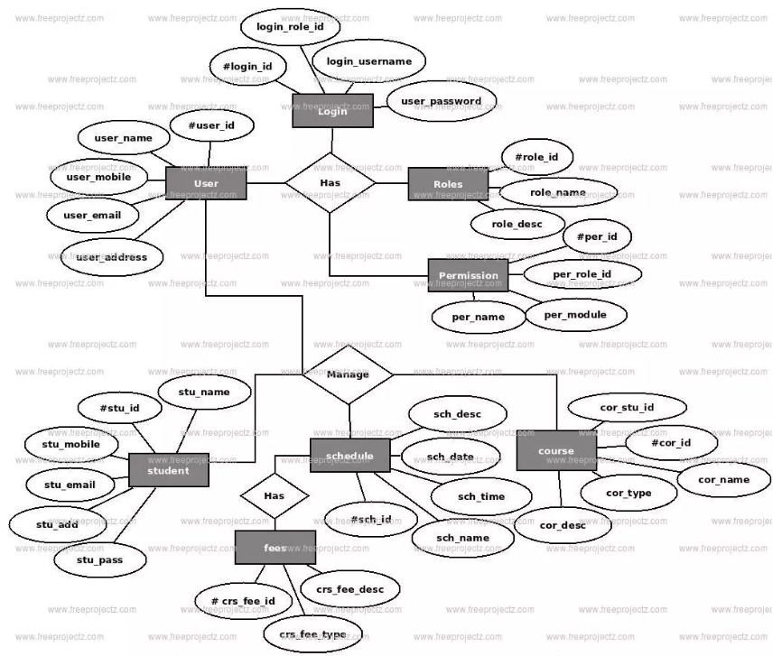
ER DIAGRAM

Slide 10
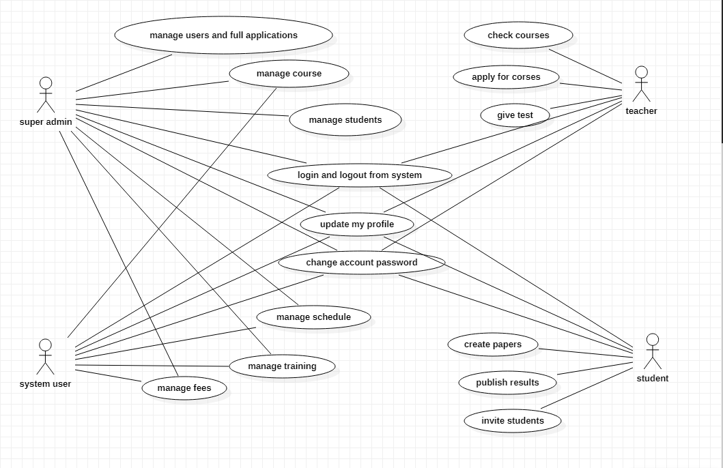
USE CASE DIAGRAM

Slide 11
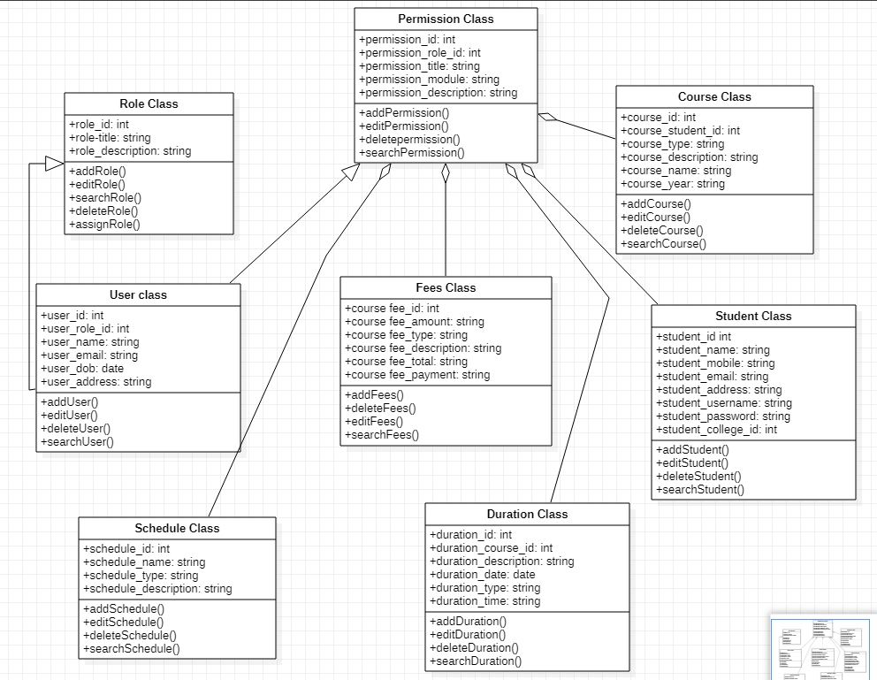
CLASS DIAGRAM

Slide 12
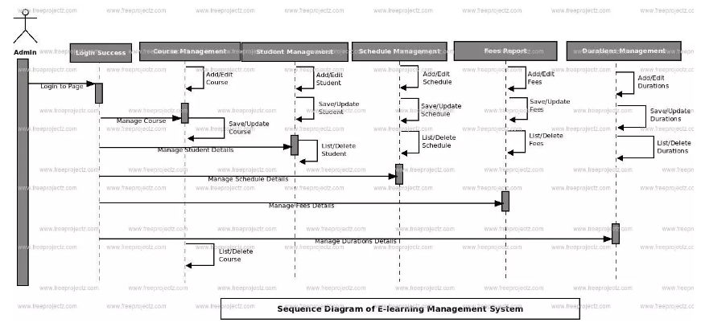
SEQUENCE DIAGRAM

Slide 13
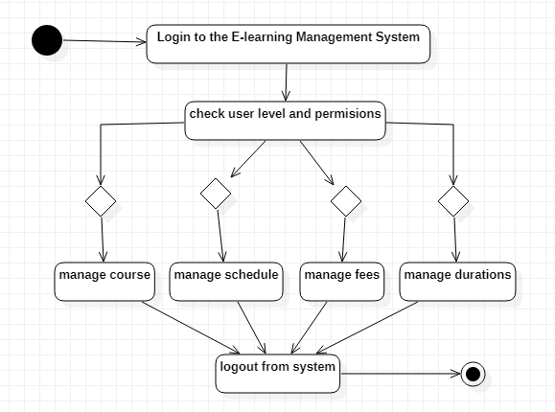
ACTIVITY DIAGRAM

Slide 14
CONCLUSION
By using this design we are able to built a Learning Management System website which helps the end users i.e. the Professor (course creator) The College Student (or user).
The Professor can create a course and publish it on the website.
The College Student can access the course published by the course creator.
The Admin can manage all the activities of the end users by keeping track of their data using MySQL database.

